Slide 1
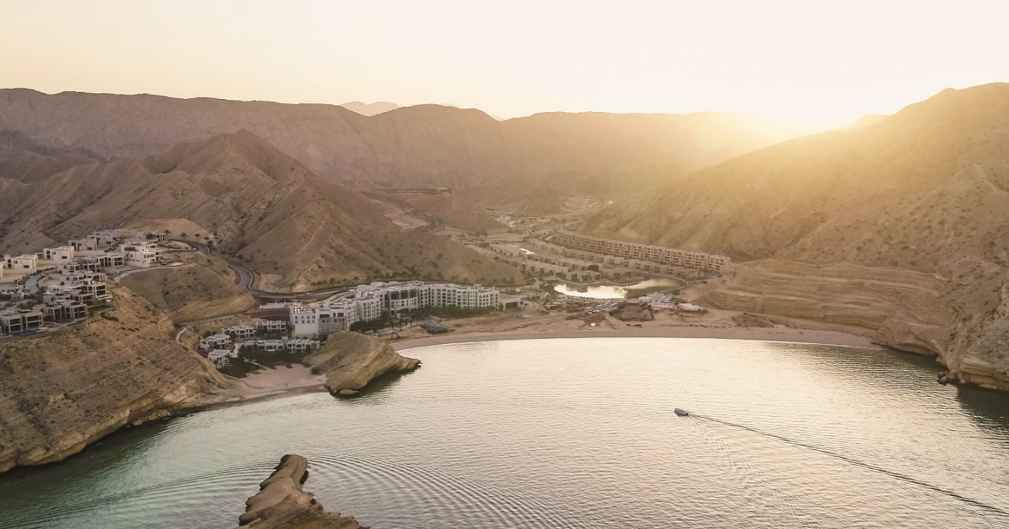
Nestled between mountains and sea, Jumeirah Muscat Bay offers true tranquility and a great sense of escaping the everyday. A sublime place to disconnect and indulge in relaxing days on the beach, adventurous hikes in the mountains or blissful moments diving in the Arabian Sea.
While set in the secluded cove of Bandar Jissah between the Al Hajar Mountains and the Gulf of Oman, this exclusive resort is just 15 minutes south of Muscat city centre and 40 minutes from Seeb International Airport and an ideal spot to also discover Muscat’s rich cultural heritage. Explorers of all ages can venture out to discover several historical and archeological sights that shape Oman’s unique history and culture. Remains of ancient villages, old seaports, modern souks or the Royal Opera House are just a few of the highlights in easy reach.
Watching the sun rise over the sparkling sea from the ocean view rooms, taking walks in the soft warm sand and diving into the blue, refreshing sea is the perfect sense of rejuvenation. The celebrated Talise Spa concept has guests continue down this path to adventurous well-being through perfectly tailored experiences. The world-renowned experts at Bastien Gonzalez’ Mani:Pedi:Cure Studio will leave you walking on clouds for the rest of your stay
Explorers can challenge themselves on numerous hikes up the Hajar mountain range and be rewarded with breathtaking views and relaxation in lush Wadis. Sport addicts can train their endurance outdoors on extensive bike rides, scenic runs or long swims, the ambitious will find a range of competitions from 10k races to the renowned Oman Desert Marathon or the ultimate endurance test Iron Man.
Family fun is guaranteed when venturing out to snorkel amidst turtles, taking a boat trip along the stunning coast in search of Dolphins, discovering historic villages or simply enjoying the many activities in our Kids Club or one our fine sand beach.

Slide 2
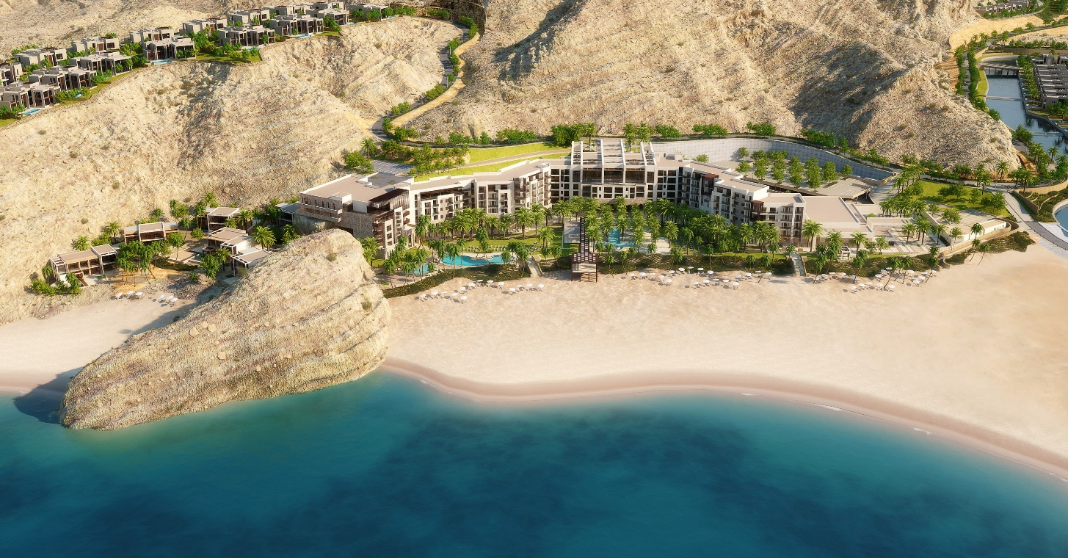
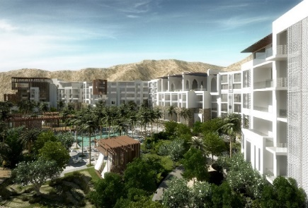
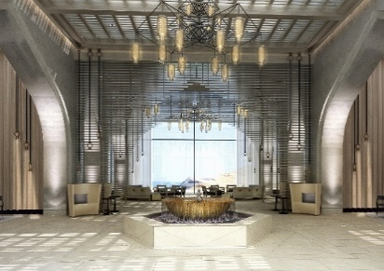
At a Glance
195 rooms, suites & villas all with ocean views
5 luxurious summerhouses with private pools
Exclusive Sanctuary Villa with private pool & jacuzzi
Summerhouses & Villa share the private Sanctuary Beach and enjoy butler service and exclusive added values
Connecting rooms and suites for the perfect family holiday
Talise Spa with 8 treatment rooms & 2 couple treatment rooms
Hammam treatment room, sauna & steam room
3 Swimming pools (kids, main & adult only)
Diving & water sports centre on Sunrise Beach
Signature Restaurant & Rooftop Bar Brezza overlooking the sea
Peridot international all day dining restaurant
Anzo Asian inspired bar
Zuka poolside dining
Tarini Lounge with „Berry Good“ Afternoon Tea
Kids club
Premium club lounge for club rooms and above
State of the art fitness centre, yoga studio and tennis court
The Pearl Grand Ballroom for private events with up to 1,000 guests boasting a beachfront terrace

Slide 3
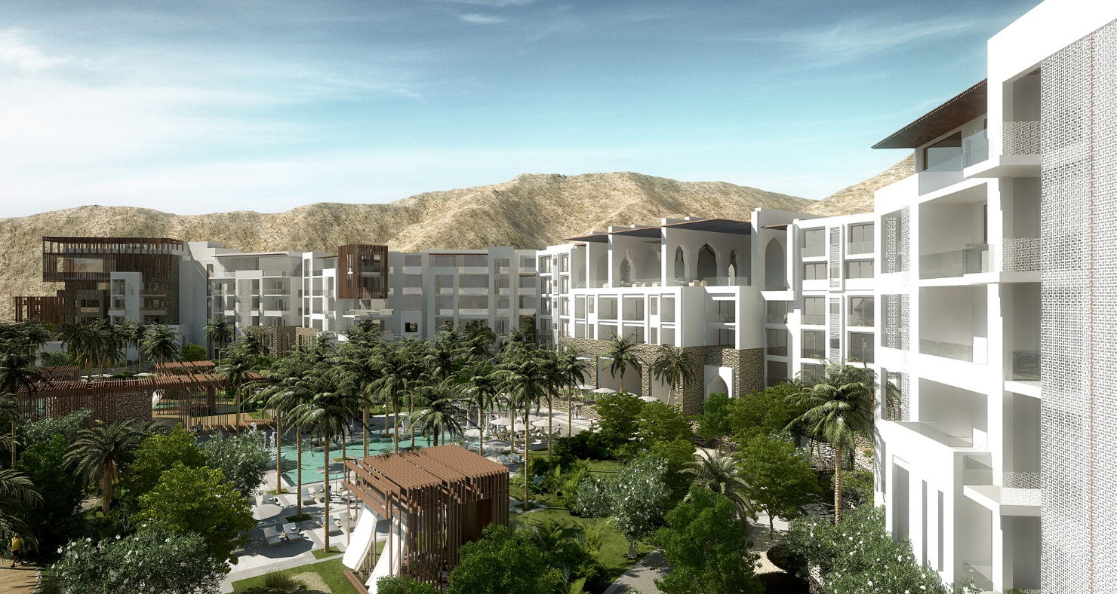
TEN REASONS TO CHOOSE JUMEIRAH MUSCAT BAY
Oman’s newest luxury resort and simultaneously Jumeirah Hotels & Resorts first project in the country boasts 195 well appointed rooms, suites & villas; all offering breath-taking ocean views
Located in the cove of Bandar Jissah, the resort offers “sunrise beach”, one of the longest hotel beaches with finest sand for peaceful relaxation.
Exclusive Summerhouses & the unique Sanctuary Villa, all with private pools, butler service and located on our exclusive “sanctuary beach”.
Recharge and Rejuvenate in world renowned Talise Spa, through perfectly tailored treatments or more adventurous well-being activities such as Yoga on a Stand Up Paddle or Meditation on a Mountain Top.
Have the perfect pedicure by the famous experts of Bastien Gonzalez’ Mani:Pedi:Cure Studio that will leave you walking on clouds.
Families will create memories of a lifetime while sailing along the stunning coast, snorkeling with turtles or learning a new water sport; kids can enjoy gamut of activities in our kids club.
Sport aficionados can challenge their endurance on outdoor extensive bike rides, scenic runs or long swims. And to a Hiker’s galore, Hajar mountains offer breathtaking views and relaxation in lush wadis.
Unwind in TARINI lounge, Dwell taste buds at our rooftop restaurant BREZZA offering elegant views, indulge in delightful cocktails at ANZO bar, Refuel at ZUKA or simply choose PERIDOT for all day dining crafted by our specialty chefs.
A masterpiece of timeless elegance the PEARL GRAND BALLROOM offers a backdrop of understated grandeur for special events and occasions.
A modern arabesque design features craftwork from local artisans and interiors reflect Omani traditions and culture in a contemporary light, all designed to offer guests the most spectacular sea views.

Slide 4
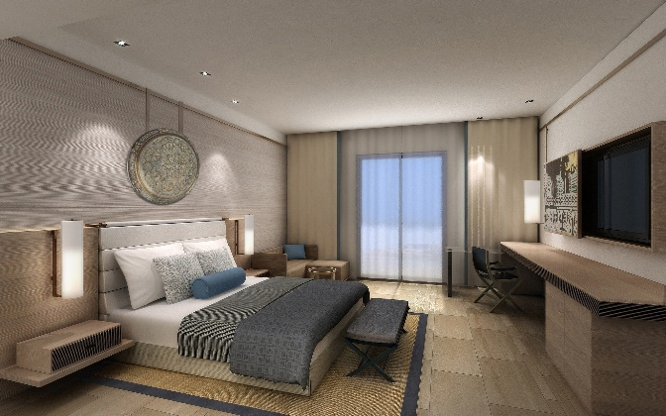
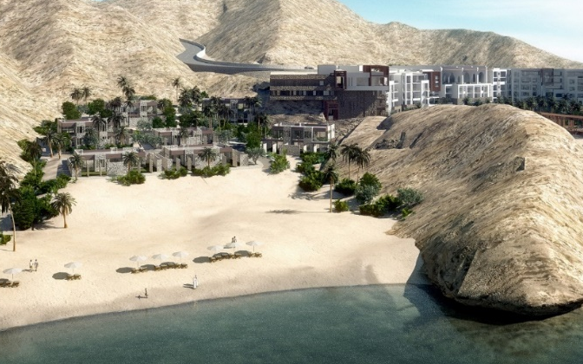
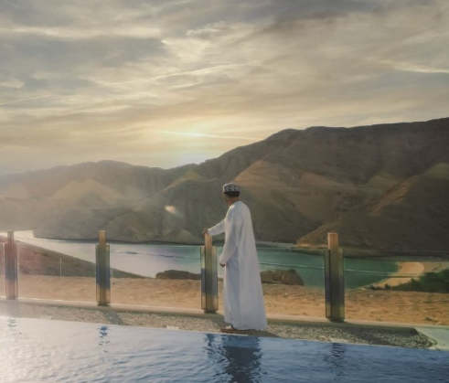
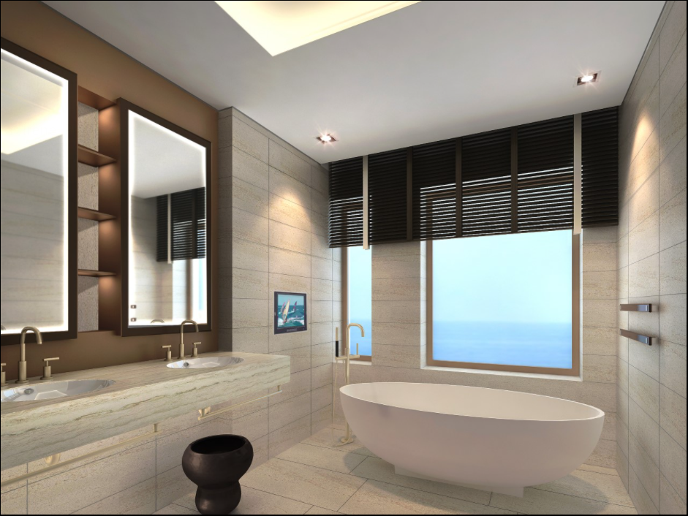
Rooms, Suites & Summerhouses
Room Type | Sizes
Deluxe Ocean Room | 44 – 49 sqm
Premium Ocean Room | 46 – 54 sqm
Club Ocean Room | 46 – 56 sqm
Junior One Bedroom Suite | 97 sqm
Family One Bedroom Suite | 98 – 102 sqm
Executive One Bedroom Suite | 98 – 104 sqm
Summerhouse 2 Bedroom with pool | 150 sqm
Sanctuary Villa with private pool | 197 sqm
Summerhouse 4 Bedroom with pool | 300 sqm
At a Glance
For bookings and further information, please contact:
Irene Fenart
Senior Sales Manager
Irene.fenart@Jumeirah.com
jumeirah.com/oman

